Slide 1
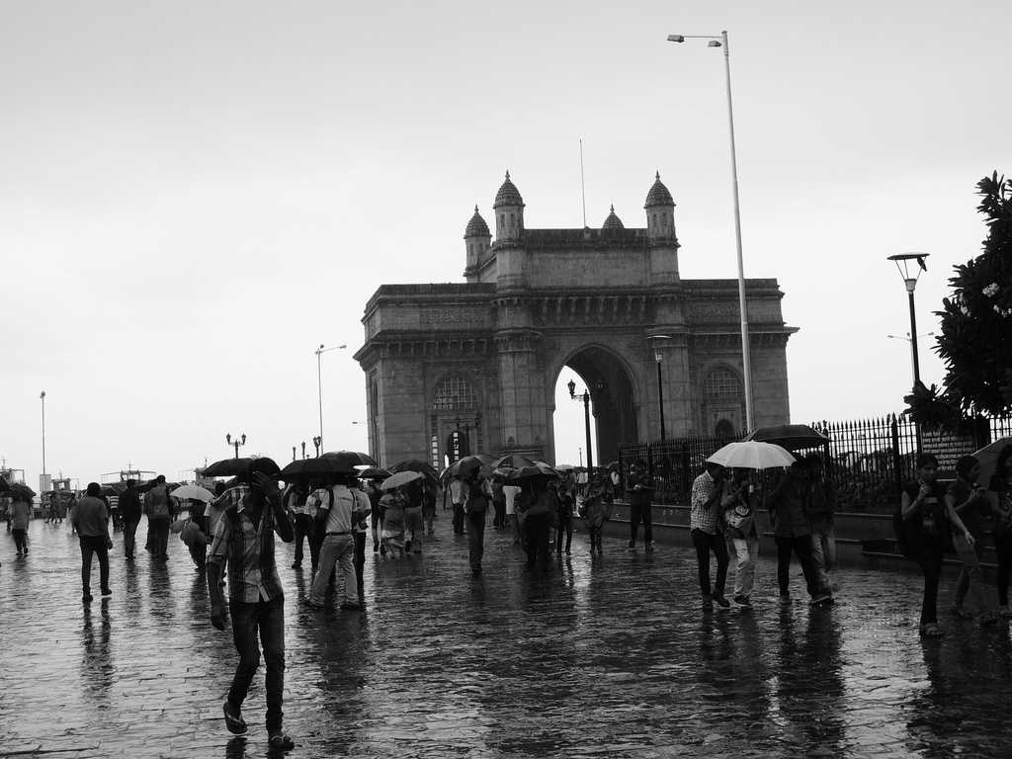
Rain Forecasting- Mumbai

Slide 2

Objective
Accurate rainfall forecasts are essential for planning water allocation, storage, and distribution strategies. It is crucial for their operations, to plan water allocation strategies and reservoir management more effectively. The goal of this project is to develop a machine learning model to forecast rainfall for upcoming months in Mumbai, India. By anticipating rainfall patterns, they can optimize their operations and minimize costs while ensuring a consistent water supply throughout the year.

Slide 3

Project Benefits
Enhanced water resource management: Anticipating rainfall patterns will allow them to optimize water allocation and storage strategies, ultimately reducing costs and ensuring a reliable water supply for Mumbai.
Improved preparedness: Early warnings of below-average rainfall will enable them to implement water conservation measures and mitigate the impact of droughts on Mumbai's water supply, enhancing the city's resilience.
Informed decision-making: Leveraging rainfall forecasts, they can plan infrastructure maintenance and upgrade projects during dry periods, minimizing disruptions and maximizing efficiency during the rainy season.

Slide 4

Predicting Mumbai Rainfall Using ARIMA and SARIMA Models
An Analysis with MSE and MAE Metrics
Project made by Kartikey Kataria

Slide 5

Data Collection
Data Collection
Data Source:
Historical rainfall data from IMD or other reliable sources.
Features Used:
Monthly/seasonal rainfall records.
Time Period Covered: [Specify the range, e.g., 1901–2021].

Slide 6

Preprocessing
Preprocessing Steps:
Handled missing values.
Decomposed time series (trend, seasonality, residuals).
Stationarity Check:
Performed ADF test (Augmented Dickey-Fuller).
Differencing applied as needed.

Slide 7
Model Selection
ARIMA Model:
Assumes strong seasonality.
Parameters (p, d, q) =(2,1,2)chosen based on ACF/PACF plots.
SARIMA Model:
Incorporated seasonal components (P, D, Q, m)=(1,1,1,4).
Better suited for monsoon cycles.

Slide 8
Metrics
Model Evaluation
Metrics Used ARIMA
Mean Squared Error (MSE): 57
Mean Absolute Error (MAE): 40
Metrics Used SARIMA
Mean Squared Error (MSE): 75
Mean Absolute Error (MAE): 68

Slide 9
Result
Comparison: SARIMA outperformed ARIMA in capturing seasonal patterns.

Slide 10
Visualizations
Actual vs Predicted Rainfall (ARIMA & SARIMA).

Slide 11
Residual of ARIMA Model

Slide 12
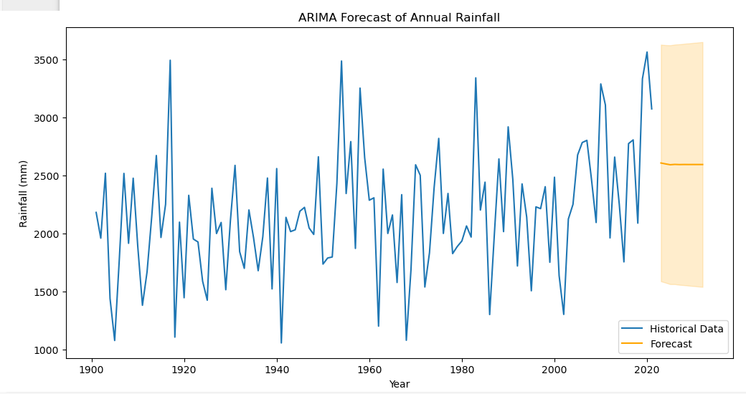
ARIMA Forecast

Slide 13
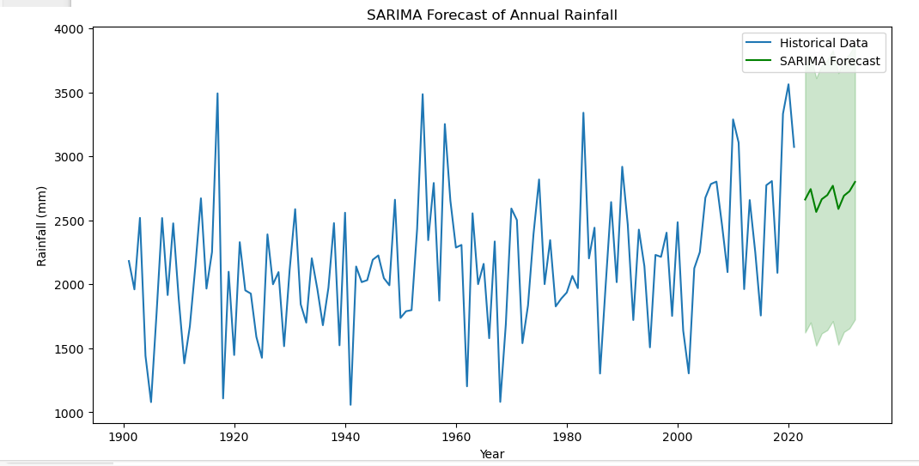
SARIMA Forecast

Slide 14
Insights
Key Findings:
SARIMA effectively captured seasonal trends.
ARIMA worked well for short-term predictions.
Challenges:
High variability in monsoon data.
Limited accuracy during extreme weather events.

Slide 15
Conclusion
Summary: ARIMA and SARIMA models demonstrated reliable forecasting with low error margins.
Takeaway: Seasonal modeling is critical for accurate rainfall prediction.

Slide 16
Further Conclusion-
This model could be used for planning in areas such as agriculture, water resource management, and disaster preparation .
Further evaluation of the model’s accuracy which is 75 (MSE) and 68(MAE).

